Slide 1



PROJECT TITLE
A MINOR PROJECT-III REPORT
Submitted by
VASANTH P | 927621BEC234
VISHAL G | 927621BEC242
SIBI VB | 927621BEC199
YUVASARAVANAN S | 927621BEC248
BACHELOR OF ENGINEERING
in
DEPARTMENTOF ELECTRONICS AND COMMUNICATION ENGINEERING
M.KUMARASAMY COLLEGE OF ENGINEERING
(Autonomous)
KARUR – 639 113
DECEMBER 2022

Slide 2
M.KUMARASAMY COLLEGE OF ENGINEERING, KARUR
BONAFIDE CERTIFICATE
Certified that this project report “Project Title” is the bonafide work of “VASANTH P(927621BEC234),VISHAL G(927621BEC242),SIBI VB(927621BEC199),
YUVASARAVANAN S(927621BEC248).”who carried out projectwork under my supervision in the academic year 2022-2023.
SIGNATURE | SIGNATURE
Dr.S.PALANIVELRAJAN, M.E., Ph.D., HEAD OF THE DEPARTMENT, | Mr.K.KAARTHIK ,M.E.,
Associate Professor, | Associate Professor,
Department of Electronics and | Department of Electronics and
Communication Engineering, | Communication Engineering,
M.Kumarasamy College of Engineering, | M.Kumarasamy College of Engineering,
Thalavapalayam, Karur-639113. | Thalavapalayam, Karur-639113.
This Minor project-III report has been submitted for the 18ECP105L – Minor Project-III
Review held at M. Kumarasamy College of Engineering, Karur on
PROJECT COORDINATOR

Slide 3
Vision of the Institution
To emerge as a leader among the top institutions in the field of technical education
Mission of the Institution
M1: Produce smart technocrats with empirical knowledge who can surmount the global challenges
M2: Create a diverse, fully engaged, learner-centric campus environment to provide quality education to the students
M3: Maintain mutually beneficial partnerships with our alumni, industry, and Professional associations Vision of the Department
Vision of the Department
To empower the Electronics and Communication Engineering students with emerging technologies, professionalism, innovative research, and social responsibility.
Mission of the Department
M1: Attain the academic excellence through innovative teaching learning process, research areas & laboratories and Consultancy projects.
M2: Inculcate the students in problem solving and lifelong learning ability.
M3: Provide entrepreneurial skills and leadership qualities.
M4: Render the technical knowledge and skills of faculty members.
Program Educational Objectives (PEOs):

Slide 4
PEO1: Core Competence: Graduates will have a successful career in academia or industry associated with Electronics and Communication Engineering.
PEO2: Professionalism: Graduates will provide feasible solutions for the challenging problems through comprehensive research and innovation in the allied areas of Electronics and Communication Engineering.
PEO3: Lifelong Learning: Graduates will contribute to the social needs through lifelong learning, practicing professional ethics and leadership quality Program Outcomes (POs):
PO 1: Engineering knowledge: Apply the knowledge of mathematics, science, engineering fundamentals, and an engineering specialization to the solution of complex engineering problems.
PO 2: Problem analysis: Identify, formulate, review research literature, and analyze complex engineering problems reaching substantiated conclusions using first principles of mathematics, natural sciences, and engineering sciences.
PO 3: Design/development of solutions: Design solutions for complex engineering problems and design system components or processes that meet the specified needs with appropriate consideration for the public health and safety, and the cultural, societal, and environmental considerations.
PO 4: Conduct investigations of complex problems: Use research-based knowledge and research methods including design of experiments, analysis and interpretation of data, and synthesis of the information to provide valid conclusions.
PO 5: Modern tool usage: Create, select, and apply appropriate techniques, resources, and modern engineering and IT tools including prediction and modeling to complex engineering activities with an understanding of the limitations.
PO 6: The engineer and society: Apply reasoning informed by the contextual knowledge to assess societal, health, safety, legal and cultural issues, and the consequent responsibilities relevant to the professional engineering practice.
PO 7: Environment and sustainability: Understand the impact of the professional engineering solutions in societal and environmental contexts, and demonstrate the knowledge of, and need for sustainable development.

Slide 5
PO 8: Ethics: Apply ethical principles and commit to professional ethics and responsibilities and norms of the engineering practice.
PO 9: Individual and teamwork: Function effectively as an individual, and as a member or leader in diverse teams, and in multidisciplinary settings.
PO 10: Communication: Communicate effectively on complex engineering activities with the engineering community and with society at large, such as, being able to comprehend and write effective reports and design documentation, make effective presentations, and give and receive clear instructions.
PO 11: Project management and finance: Demonstrate knowledge and understanding of the engineering and management principles and apply these to one’s own work, as a member and leader in a team, to manage projects and in multidisciplinary environments.
PO 12: Life-long learning: Recognize the need for and have the preparation and ability to engage in independent and life-long learning in the broadest context of technological change.
Program Specific Outcomes (PSOs):
PSO1: Applying knowledge in various areas, like Electronics, Communications, Signal processing, VLSI, Embedded systems etc., in the design and implementation of Engineering application.
PSO2: Able to solve complex problems in Electronics and Communication Engineering with analytical and managerial skills either independently or in team using latest hardware and software tools to fulfil the industrial expectations Program Specific Outcomes
PSO1: Applying knowledge in various areas, like Electronics, Communications, Signal processing, VLSI, Embedded systems etc., in the design and implementation of Engineering application.
PSO2: Able to solve complex problems in Electronics and Communication Engineering with analytical and managerial skills either independently or in team using latest hardware and software tools to fulfil the industrial expectations.

Slide 6
ABSTRACT
This paper Consists of the GSM-based automatic booking of a new LPG cylinder and also detects the gas leakage. Usually, the capacity of LPG in the Cylinder is not determined, so we are going to display the level of LPG. The level of LPG is measured using the load sensor. The output of the sensor is connected with Arduino R3. By the use of the GSM Module, the information is sent to the user by SMS and also automatic booking is done by dialing the registered gas booking number. Then the gas leakage is detected by the gas sensors (MQ-6). By using this, we can detect the current LPG level and it is continuously displayed on the LCD. We can know the validity of LPG usage from the date of initialization. By use of GSM, the user is alerted by giving the message to their mobile phone when the LPG level is critically low (below 20%). Automatic booking of new LPG by auto-dialing of gas booking number and by this we prevent prebooking and late booking. Then by detecting the gas leakage, we can prevent the LPG gas burst accidents in the home.

Slide 7
Chapter No. |  | Particulars | Page No.
 | Vision and Mission of the Institute and Department |  | 3
 | POs, PSOs of the Department |  | 4
 | Mapping of project with POs and PSOs |  | 5
 | Abstract |  | 6
 | List of Figures |  | 8
 | Acronyms/List of Abbreviations |  | 9
1 | Introduction |  | 10
 | 1.1 | Objectives | 11
2 | Literature Review |  | 12
3 | Project Methodology |  | 15
 | 3.1 | Existing Method | 15
 | 3.2 | Proposed Method | 16
4 | Results and Discussion |  | 27
5 | Conclusion |  | 28
6 | References |  | 29

Slide 8
List of figures
Figure no | Figure name | page no
1.1 | Flow chart | 17
1.2 | circuit diagram | 18
1.3 | Ardiuno controller | 20
1.4 | GSM module | 21
1.5 | Gas sensor | 22
1.6 | Load cell | 23
1.7 | LCD display | 24
1.8 | Buzzer | 25
1.9 | Result and Discussion | 27

Slide 9
Acronyms
GSM | Global System for Mobile communication
SMS | Short Message Service
WSN | Wireless Sensor Network
LCD | Liqiud Crystal Display
GPS | Global Positioning System
LPG | Liquified Petroleum Gas
IOREF | Input Output Reference
SDA | Serial Data
SCL | Serial Clock

Slide 10
1. INTRODUCTION:
There are approximately 30crore LPG users in the country in which mostly 40% of the population. The Several standards have been implemented for the gas leakage detection system. The existing systems provides an alarm system which is mainly meant to detect an Gas leakage in the house and commercial premises The objective of the proposed system is to continuously measure the weight of the cylinder and as soon as it reaches the minimum threshold it will automatically sends an SMS alert to the user as well as Authorized LPG agent so that they can act accordingly. This system also designed to detect LPG gases such as propane and butane. The allowed level for butane is 600ppm above which it is considered to be of high level and poses a danger. The threshold level of weight of the cylinder is used for automatic cylinder booking. The main aim of this project is to monitor for liquid petroleum gas (LPG) leakage to avoid major fire accidents and also facilitating safety precautions where security has been an important issue and automatic cylinder booking without human intervention. The system detects the leakage of the LPG using gas sensor and alerts the consumer about the gas leakage by sending SMS. The system measure the weight of cylinder by using weight sensor and display corresponding weight in LPG display. The proposed system uses the GSM Modem to alert the person about the gas leakage via SMS and status of automatic cylinder booking. When the system identifies that LPG concentration in the air reaches the specified level then it alert the consumer by sending SMS to registered mobile phone and alert the people at home by activating the alarm which includes Buzzer simultaneously and also display the same message on LCD to take the necessary action and switch on the exhaust fan or opening windows to decrease the gas concentration in the air.

Slide 11
1.1Objectives
These sensors can be used for various applications, e.g. monitoring and controlling of the explosive level of concentration of gases, finding of various harmful, dangerous, toxic gases, industrial automation etc. In recent years, the biggest advancement made in the sensor tools is the detection of liquefied petroleum gas and has become tip of the iceberg because outburst accidents force to be happened when it leaks excessively. Therefore, the research work particularly, in the area of wireless sensor network and earlier gas leakage detection (alert system) is imperative. The monitoring, reorganization and controlling of the data are the key concern of Wireless Sensor Network. The inaccessible interface and actual monitoring with the physical world can be done easily by mote of the network. The wireless sensor networks differ from general data networks, because WSN are application oriented, planned and deployed for dedicated purpose. The wireless sensor network provides extensive range of the such as in green monitoring, defense, health, etc. The litheness in plan, enhanced mobility, consistency, broadcast range, reduced power, cost-effective etc. are the good features of these network. Additionally, the system uses the ZigBee technology for wireless communication. This technology is most trustworthy and apposite for interior and outdoor applications. The ZigBee can be configured in star, mesh or peer to peer topology. A demanding subject in scheming WSNs is inadequate power supply for sensor nodes in some application. The breakdown of a mote results in degradation of the entire network. The preference of a topology can play an imperative role in reduction of power consumption. The present system is mainly used for the detection of LPG gas. If gas leakage happens at certain place, the present system detects the LPG gas alerts the peoples by buzzer ring and sending SMS on Arduino GSM shield compatible to the Arduino board. The monitoring of the sensor node can be done using C-code created in Arduino. The current system provides genuine instance notifications. This system can be installed in a place where LPG is used as a fuel and leakage happens instantly. The present wireless gas detection system plays imperative role model to industry as well as general public

Slide 12
2. LITERATURE REVIEW 1
This system represented the versatile nature of LPG it is used for many needs such as domestic fuel, industrial fuel, automobile fuel, heating, illumination etc and the demand for LPG is on an exponential raise day by day. The leaked gases when ignited may lead to severe explosion. The number of deaths due to the explosion of gas cylinders has been increasing in recent years. Thus, there is a need for a system to detect and also prevent leakage of LPG.This project is to detect the presence of LPG leakage as a part of a safety system. Apart from sound alarm, an SMS alert will inform the authorized person and the solenoid valve will be triggered to shut down the gas supply to prevent any harmful effects due to gas leakage leakages are a mutual hindrance in household and manufacturing nowadays. It is very life threatening if you will not distinguish and modified right away. The idea behind our project is to give a solution by power cut the gas provision as soon as a gas leakage is perceived apart from activating the sounding alarm. Paper [3] This system presented the main objective of the work is designing microcontroller based toxic gas detecting and alerting system. The hazardous gases like LPG and propane were sensed and displayed each and every second in the LCD display. If these gases exceed the normal level then an alarm is generated immediately and also an alert message (SMS) is sent to the authorized person through the GSM. The advantage of this automated detection and alerting system over the manual method is that it offers quick response time and accurate detection of an emergency and in turn leading faster diffusion of the critical situation.

Slide 13
LITERATURE REVIEW 2
Pipeline Gas Leakage Detection And Location Identification System.Every diminutive task in this planetary is machine-controlled by cyberspace of belongings which makes our life easier. Now internet of things is used for safety purpose also. Nowadays outflow of gas in pipeline is the major difficulty. The chief mental object of this project is to detect the leakage of gases in the pipeline. Pipeline will be monitored with in an regular intervals using gas detection sensors. If there is any leakage in the pipeline then it will be detected and information such as name of the gas, pressure rate of the gas and its location where there is leakage of gases will be passed to the mobile phone, laptops, etc using . The accurate location for the gas leakage will be detected using the GPS.

Slide 14
LITERATURE REVIEW 3
Development of Smart Cooking Stove: Harvesting Energy from the Heat, Gas Leakage Detection and IoT Based Notification System.The design and implementation of smart cooking stove with safety features has been discussed in this paper. To increase the efficiency of the conventional cookingstove, an energy harvest system from cooking heat has also been proposed in this research work. Heat absorbing body and Thermoelectric Cooler (TEC) module are used for this purpose. Heat is absorbed to generate power by using seebeck effect through TEC module. Generated power can be stored in a battery which can be delivered to the load. Sensor based safety feature has been implemented which can detect the leakage of gas and notify the user through mobile message using an IoT server.

Slide 15
PROJECT METHODOLOGY:
Existing Method
This system helps you to upgrade your safety standards. Most importantly protect life and property from disaster by preventing accidents. It detects the malfunction of a pressurized gas system, so that accumulation of combustible gases and their explosion can be prevented. It also detects the leakage of gas into the area of an appliance when it is in a shutdown condition and not in operation. This system provides gas detection and monitoring which is economical to manufacture and which may be readily installed in conventional trailers and boats which are normally dependent upon a stored supply of pressurized gas. Gas leakage is a serious problem in household, gas vehicles and industries. Gas leakage leads to various accidents resulting into both financial loss as well as human injuries. In context with these issues, the proposed design is able to detect and monitoring gas leakage. The system detects gas leakage and alerts the subscriber through alarm the report consists of a background into the area of PIC16F877A microcontroller and Zigbee Module, how they are communicating to each other. Microcontroller based LPG Gas Leakage Detectors Zigbee Module is the system where lot of researcher working on it for its developments from all over the world. Since then, many systems and devices have been developed to detect, monitor, and alert the leakage of a wide array of gases. In the existing method, different gas sensing technology is used. This gas leakage is detected by the semiconductor sensor

Slide 16
3.2 Proposed Method
Gas leakages results a serious problem in household and other areas where household gas is used, therefore the proposed gas leakage detection and monitoring system is developed. There are many methods available for booking a Gas Refill, methods include online booking, telephonic booking etc. It will be difficult situation for the one who uses LPG gas for cooking regularly. The aim of this paper is to present a new system automatically books a cylinder when the gas is about to empty is by sending a notification to the gas agency GSM. In addition to that sensor is used to detect gas leakage at home. If the gas leakage is sensed automatically it will send SMS to the user. GSM is one of the most used networks across the world. Hence, load cell has been used to monitor the weight of the LPG gas regularly. The values are next fed to the microcontroller. If the gas in the cylinder indicates a value where the remaining percentage level is crossed below the threshold level set for gas to be indicated as getting emptied, then a notification will be delivered to gas enterprise automatically to book the new cylinder. Subsequently, reply notification will be sent to the customer about the booking status. At the same time, application software is developed in the gas enterprise to inform and record the booking. This, work this helps the society to specifically indicate gas leakage and also helps both customers and the agency to get the gas booking made automatically using the GSM technique. This device will continuously monitor the level of LPG gas present in the air. Buzzer will on and whenever the gas exceeds solenoid value will turn off. Gas Refill, methods include online booking.

Slide 17
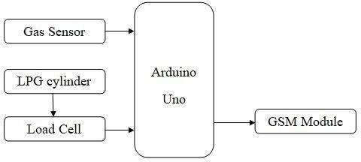
FLOW CHART:
Fig no 1.1

Slide 18
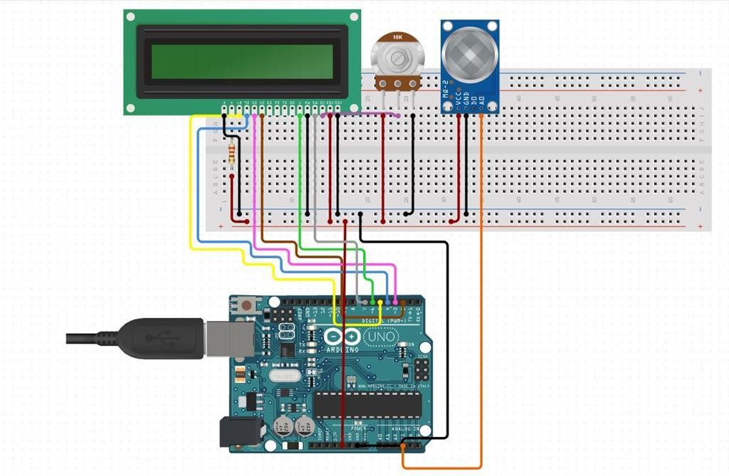
Circuit diagram
Fig no 1.2
GSM and Arduino based LPG leakage detection system senses the LPG gas with the help of an LPG gas sensor. LPG gas sensor interfacing with Arduino is implemented in this project. The Signal from this sensor is sent to the Arduino microcontroller. The microcontroller is connected to an LCD, Buzzer and Gsm module LPG leakage detector project is implemented using a sim 900. The T module then sends the data over to a website. Once the gas requisite for this LPG gas leakage detection and the smart alerting project is that the Wi-Fi module should be connected to a Wi-Fi zone or a hotspot. We have used various components in the IOT and Arduino based LPG leakage detection system. LPG Gas Sensor is used to detect the gas leakage. Arduino is used to turning ON the buzzer, to send a message to LCD and to send data to the IOT module. LCD is used to display an informative message. A buzzer is used to

Slide 19
signal the gas leakage. And GSM is used to send data network. This device will continuously monitor the level of LPG gas present in the air. Buzzer will on and whenever the gas exceeds solenoid value will turn off. Gas Refill, methods include online booking.
HARDWARE IMPLEMENTATION
COMPONENTS DETAILS
Arduino Controller
Powersupply
Gsm
Lcd Display
Gas Sensor
Load Cell
Buzzer
Relay

Slide 20
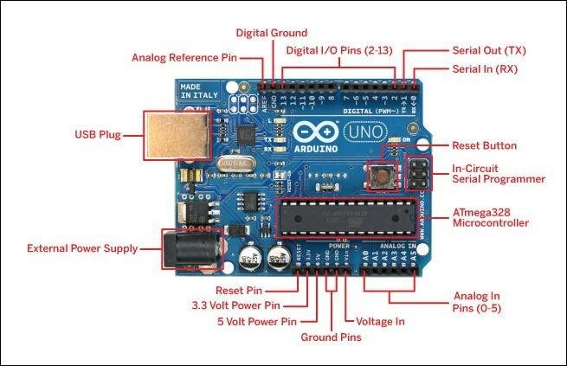
ARDUINO CONTROLLER
Fig no 1.3
The Arduino Uno is one of the most common and widely used Arduino processor boards. There are a wide variety of shields (plug in boards adding functionality). It is relatively inexpensive (about $25 - $35). The latest version as of this writing (3/2014) is Revision 3 (r3):
· Revision 2 added a pull-down resistor to the 8U2 HWB line, making it easier to put into DFU
(Device Firmware Update) mode · Revision 3 added o SDA and SCL pins are now brought out to the header near the AREF pin (upper left on picture). SDA and SCL are for the I2C interface o IOREF pin (middle lower on picture that allows shields to adapt to the voltage provided o Another pin not connected reserved for future use The board can be powered from the USB connector (usually up to 500ma for all electronics including shield), or from the2.1mm barrel jack using a separate power supply when you cannot connect breadboard to PCs usb port.

Slide 21
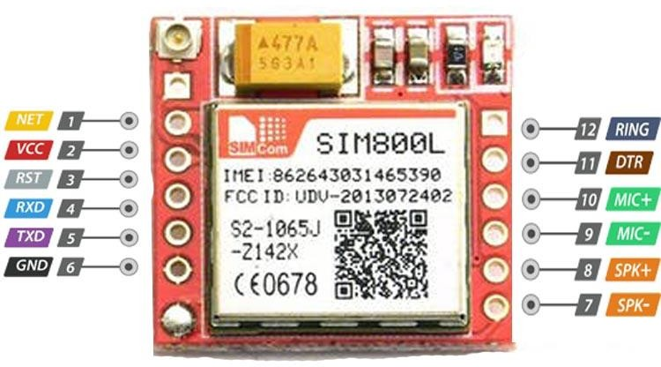
GSM MODULE
Fig no 1.4
GSM (Global System for Mobile) / GPRS (General Packet Radio Service) TTL modem s SIM900 quad-band GSM / GPRS device, works on frequencies 850 MHZ, 900 HZ, 800 MHZ and 1900 HZ. It is very compact in size and easy to use as plug in GSM Modem. The Modem is designed with 3V3 and 5V DC TTL interfacing circuitry, which allows User to directly interface with 5V microcontrollers (PIC, AVR, Arduino, 8051, etc.) as well as 3V3 Microcontrollers (ARM, ARM Cortex XX, etc.). The baud rate can be configurable from 9600- 115200 bps through AT (Attention) commands. This GSM/GPRS TTL Modem has internal TCP/IP stack to enable User to connect with internet through GPRS feature. It is suitable for SMS as well as DATA transfer application in mobile phone to mobile phone interface. The modem can be interfaced with a Microcontroller using USART (Universal Synchronous Asynchronous Receiver and Transmitter) feature

Slide 22
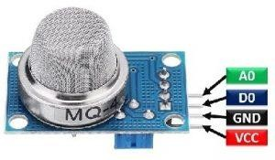
GAS SENSOR
Fig no 1.5
MQ-4 is a Sensor for Natural Gases Sensitive material. MQ-4 gas sensor is SnO2, which has lower concentration rising. we used simple circuit to convert respective output signal according to concentration level. MQ-4 gas sensor has high sensitive to Methane, Propane and Butane. The sensor can be used to detect different combustible gas, especially Methane; it is with cost effective and useful for so many applications

Slide 23
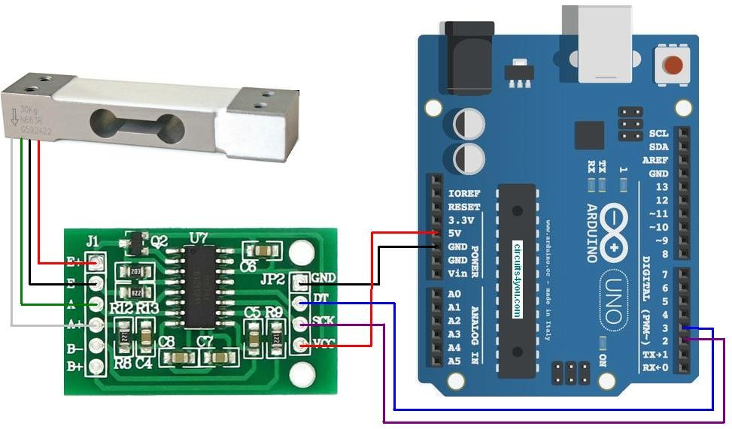
LOAD CELL
Fig no 1.6
A load cell (or loadcell) is a transducer which converts force into a measurable electrical output. Although there are many varieties of force sensors, strain gauge load cells are the most commonly used type. Except for certain laboratories where precision mechanical balances are still used, strain gauge load cells dominate the weighing industry. Pneumatic load cells are sometimes used where intrinsic safety and hygiene are desired, and hydraulic load cells are considered in remote locations, as they do not require a power supply. Strain gauge load cells offer accuracies from within 0.03% to 0.25% full scale and are suitable for almost all industrial applications. A load cell works by converting mechanical force into digital values that the user can read and record. The inner working of a load cell differs based on the load cell that you choose. There are hydraulic load cells, pneumatic load cells, and strain gauge load cells. Strain gauge load sensors are the most commonly used among the three. Strain gauge load cells contain strain gauges within them that send up voltage irregularities when under load. The degree of voltage change is covered to digital reading as weight. Load cells represented the first major design change in weighing technology. In today's processing plants, electronic force sensors are preferred in most applications,although mechanical lever scales are still used if the operation is manual and the operating and maintenance personnel prefer their simplicity.

Slide 24
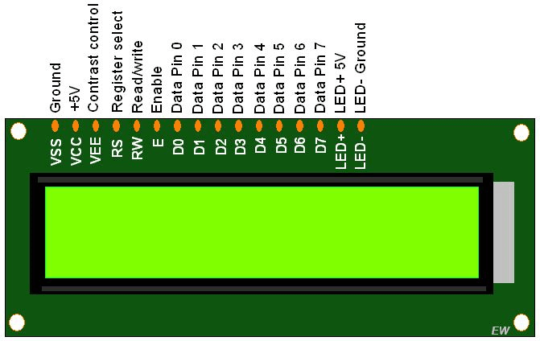
LCD DISPLAY:
Fig no 1.7
A 16x2 LCD means it can display 16 characters per line and there are 2 such lines. In this LCD each character is displayed in 5x7 pixel matrix. The 16 x 2 intelligent alphanumeric dot matrix display is capable of displaying 224 different characters and symbols. This LCD has two registers, namely, Command and Data.

Slide 25
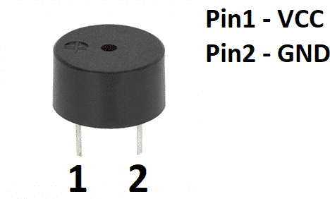
BUZZOR:
Fig no 1.8
It includes two pins namely positive and negative. The positive terminal of this is represented with the '+' symbol or a longer terminal. This terminal is powered through 6Volts whereas the negative terminal is represented with the '-'symbol or short terminal and it is connected to the GND terminal.
A buzzer or beeper is an audio signaling device, which may be mechanical, electromechanical, or piezoelectric (piezo for short). Typical uses of buzzers and beepers include alarm devices, timers, train and confirmation of user input such as a mouse click or keystroke.

Slide 26
4.FUTURE SCOPE:
This monitoring system can be further enhanced by using Bluetooth in place of GSM to send the alert messages to user, which supports the another real-time application. For industrial purposes mobile robot can be developed for detecting multiple gas concentrations. Addition of load cell can also be used as pressure sensor which detects the amount of gas in the cylinder and also detects high pressure gas in cylinder pipe, displaying the alert messages via SMS and LCD displays

Slide 27
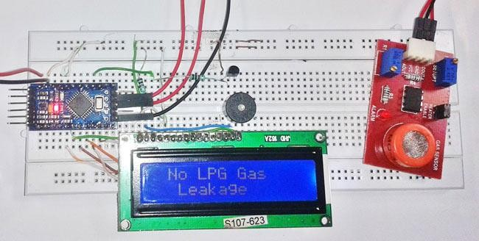
5. RESULTS AND DICUSSION
Fig no 1.9
As we shorted out the problems faced by LPG gas consumers so we come up with some solutions to meet the few requirements of them, as we made our system is completely automate the process of refill booking without human intervention. Our system is also reasoned to help customers to upgrade their safety norms, act in accordingly with minimum requirements on environmental issues and mostly the basic function being prevented by major disasters and protect life and property from reputed Accidents. The primary objective of our project is to measure the gas present in the cylinder when weight of the cylinder is below the fixed load, this can be done using the weight sensors. The gas retailer gets the order for a new cylinder and the house owner (consumer) receives the message regarding the status and the secondary objective is to provide any malfunction in gas servicing system in order to prevent damage or explosion of LPG. Thus the system developed by us will somehow help the LPG Gas Consumers to lead a comfortable life

Slide 28
6. CONCLUSION
The main advantage of this simple gas leak detector is its simplicity and its ability to warn its users about the leakage of the LPG gas. The future aspects of this detector include the gsm module and a tripper circuit which increases the efficiency of the system and provides more safety to the users. The other advantage of this system includes its visual warning systems. This detector is implemented successfully and is easy to use and also a low cost product. Another advantage of this device is that even though if no one is there in the house and then gas leaks occurs, GSM module is there to send immediate messages to the users regarding the gas leak and thus it lowers the intensity of accidents. GSM module in this device ensures better safety regarding the gas leaks.

Slide 29
7. REFERENCE:
J.Ding, J.Wang, N.Yuan, and Q.Pan, “The Monitoring System of Leakage Accidents in Crude Oil Pipeline based on Zigbee Technology”, IEEE Changzhou University, 2011.
Rakesh, M., Dagadi, S., “Implementation of Wireless Gas Leakage Detection System”, Proceedings of the International Conference on Sensing Technology, ICST, art. no. 6461747 , pp. 583-588.2012.
H.Yang, Y.Qin, G.Feng, and H.Ci, “Online Monitoring of Geological CO2 Storage and Leakage Based on Wireless Sensor Networks.”, IEEE BEE Sensors Journal, 2013.
Huan Hui Yan, Yusnita Rahayu “Design and Development of Gas Leakage Monitoring
System using Arduino and ZigBee”, International Conference on Electrical Engineering, Computer Science and Informatics (EECSI 2014), Yogyakarta, Indonesia, 20- 21 August 2014.
Badri Narayan Mohapatra, Aishwarya Dash, Dhiraj Kumar Chaubey, “LPG Gas Auto
Booking By GSM and Leakage Detection with Auto Switchable Exhaust Fan” International Journal of Science, Engineering and Technology Research (IJSETR) Volume 6, Issue 3, March 2017, ISSN: 2278 -7798.
Scott, Stuart L., and Maria A. Barrufet “ Worldwide assessment of industry leak detection
capabilities for single & multiphase pipelines” College Station: Offshore Technology Research Center, 2003

